Slide 1



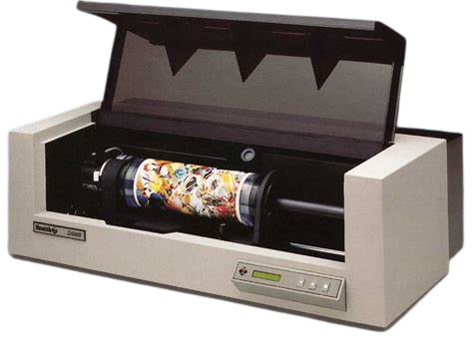
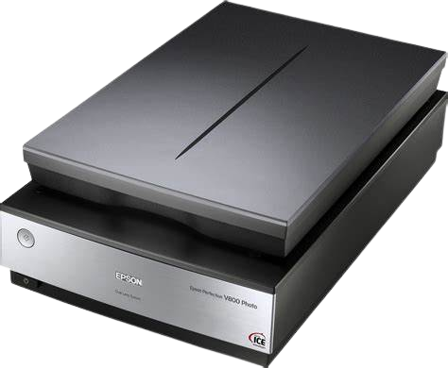
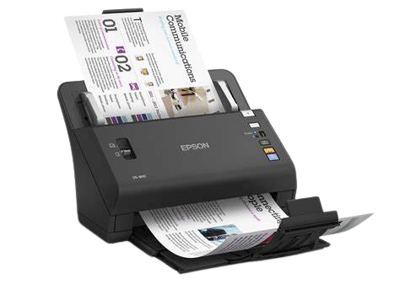
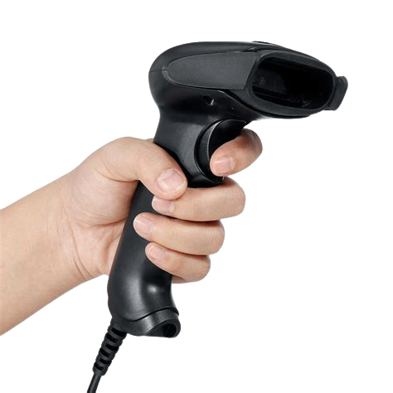
C. U. SHAH (GOVT) POLYTECHNIC
SURENDRANAGAR
COMPUTER ENGINEERING DEPARTMENT
C. U. SHAH (GOVT) POLYTECHNIC
SURENDRANAGAR
COMPUTER ENGINEERING DEPARTMENT
C. U. SHAH (GOVT) POLYTECHNIC
SURENDRANAGAR
COMPUTER ENGINEERING DEPARTMENT
Topic : Combinational Circuit
Topic : Types of Scanner and its Troubleshooting
Scanner:-
A scanner, is a device used to analyze an image and process it.
There are 4 different types of scanners:--
Flatbed Scanners
Sheet-Fed Scanners
Hand-Held Scanners
Drum Scanners
Flatbed Scanner:--
This is the most common type of scanner.
It is used for scanning most documents, photos, from a PC or laptop. It works like a copy machine.
Sheet-Fed Scanner:--
Used to scan paper documents and photos.
Usually smaller than a flat-bed.
Portable.
Hand-Held Scanner:--
Smaller than the previous two scanners.
The user must move the scanner across the document.
Image quality is usually lower.
Drum-BedScanner:--
Used by the publishing industry.
Document is placed on a glass cylinder.
Generates very high quality scans.
Troubleshooting:-
Ensure that the scanner is getting power:--
If your scanner is not getting power,you must check all the scanner's electrical connections. Make sure they are connected properly.
If the scanner is getting power, you should notice the inside light come on when the power is first received by the scanner.
After checking the connections, if you still get no power to the scanner, we must contact the manufacturer of the scanner.
Update the drivers:--
Verify the latest drivers are installed for the operating system that are used on your computer.
Scanner Not Detecting:--
Check if the scanner is properly connected or not. If not then connect it properly.
If the scanner is not working in one PC then try it on another pc, if it works it in another PC then there might be problem in your PC.
Negative image while scanning:--
If the image comes out negative (example, white paper becomes black), then select Invert Black and White Images in the Scanner Options. Attempt to make the PDF again.
Prepared By -
Jimit .S. Dagli (206090307002)
Vishal .R. Parmar (206090307031)
Sumeet .K. Kapadia (206090307059)
Tirth .M. Doshi (206090307063)
Guided By -
Mrs N.J.Rachhadiya (Lecturer – Computer Engg. Dept.)

